Slide 1

HUSKIE MOTOR CORPORATION BUSINESS REPORT
-Sohini Chintala

Slide 2
Table of Contents
Executive summary
Introduction
Business Overview
Main Body
Data Tabulations/Visualizations
Recommendations
Page 3
Page 5
Page 6
Page 7 - 20
Page 8, 12, 16, 19
Page 21

Slide 3

Executive Summary
The objective of this report is to perform an in-depth analysis of Huskie Motor Corporation (HMC). HMC is an automotive manufacturer that engages in the production and sale of vehicles across the world. This report analyzes the key issues, challenges, and opportunities that HMC encounters in the highly competitive global automotive manufacturing market, utilizing data from the provided dataset.
The report contributes to understanding of data and its application within an organization to facilitate growth and business development and to fuel data-driven decision making. A careful review and cleansing of the presented data set ensured that its quality was sufficient to support accurate conclusions and recommendations.
A detailed examination of the company's performance via graphical representation reveals the areas that have more taxes and decreased revenues, which ultimately lead to a decline in profitability. The data supplied were cleansed and interpreted using Tableau, a visual analytics platform that also facilitated the creation of the graphs presented in the report.

Slide 4
Executive Summary
This report will examine the data collection and analysis procedures, and present suggestions and anticipated challenges pertaining to efficient data management that the organization may contemplate implementing in the future to enhance its progress in the industry.
Some of the main topics examined in this report are:
The profitability of the highest and lowest performing regions
The performance of specific brands and models manufactured by HMC
Contribution Margin per Models and Channels
Financial comparisons of profitability in prior years
Recommended courses of action for the Company
Data has been analyzed through an effective dashboard system, recommending the company to make an effort to ensure their data is always at a high and secure quality.

Slide 5

Introduction
Huskie Motor Corporation (HMC) is a company that manufactures and distributes automobiles across 15 countries. In recent years, businesses have placed a higher priority on the accumulation and utilization of big data, and the automotive industry has also followed the same track. HMC has collected extensive volumes of transactional data, however, there is scope for improvement in their data collection and compilation processes to optimize sales opportunities and establish a stronger presence for the organization within the automotive sector.
The objective of the report is to streamline the data framework in a manner that facilitates the attainment of the organization's objectives, with a particular focus on improving the profitability information to enable the company to efficiently increase its value by utilizing accurate and up-to-date financial data.

Slide 6



Business Overview
The primary objective of analyzing HMC data is to gain an understanding of the company's present position within the industry and to establish creative approaches focused on improving operations and increasing revenue. HMC needs to gather and combine information and data on every car produced and sold in order to develop a business model that can forecast future sales. This will involve generating dashboards that include data, graphs, and charts, enabling a clearer understanding of the factors that contribute to improved business performance.
HMC is currently selling in 30 countries grouped into six regions: Africa, Asia, Europe, Middle East, North America, and South America. It is a spin-off of the parent company Blue Diamond Automotive. HMC is a relatively new and minor participant in the car production industry. However, the company has a number of highly recognized companies and excellent client satisfaction. The company needs to have a thorough understanding of their markets, clientele, and expenses in order to maintain profitable margins if they want to thrive in the industry.
Despite the company's sales growth, the data was not adequately organized and utilized due to a lack of knowledge, resources, and analysis of reports. The organization presently uses a complex dataset that causes challenges for the management in terms of effective interpretation. The purpose of the report is to optimize the data to assist with the business objectives, with an on improving the accuracy and timeliness of sales and profits.

Slide 7

Overall Performance Analytics:
How is HMC performing globally?
How are various HMC brands performing?
How are the various sales channels performing?
What are the most & least profitable models?

Slide 8
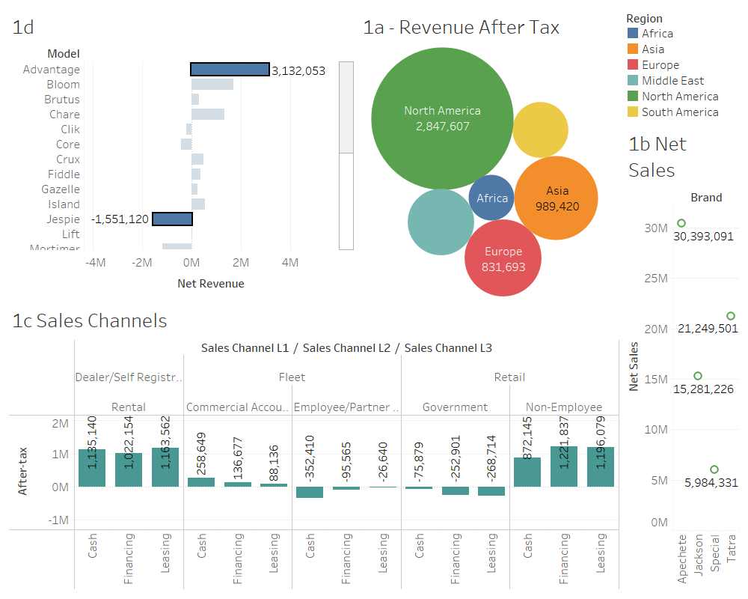

Slide 9
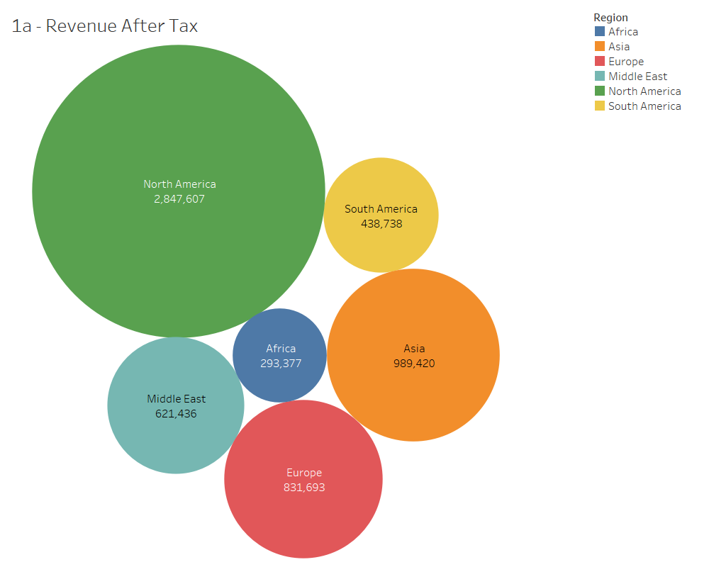
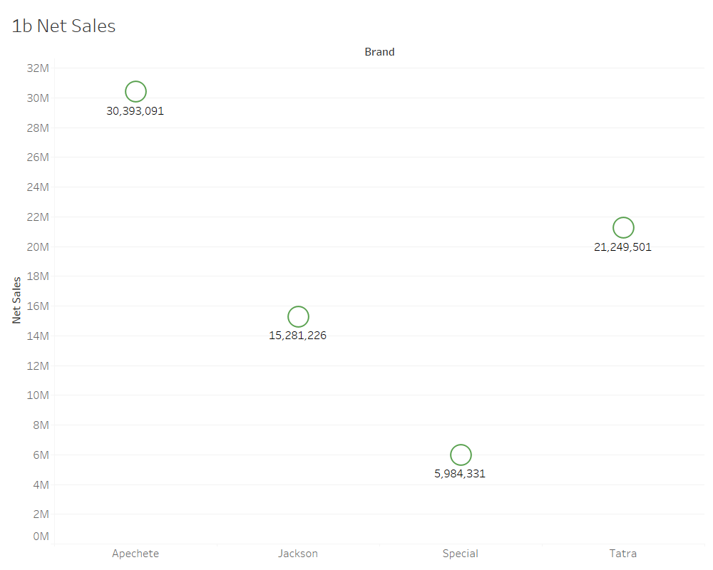
Overall Performance Analytics:
How is HMC performing globally?
North America generates the highest after-tax profit, being responsible for 47.28% overall. In particular, the after-tax revenue of the US is where HMC generated the highest operational efficiency. This is followed by Asia generating around 16.43% of the total revenue after tax, followed by Europe with 13.81%, Middle East with 10.32%, South America around 7.29% and Africa with 4.87%.
b. How are various HMC brands performing?
Apechete makes up for 41.69% of HMC’s total sales, followed by Tatra with around 29.15%, then Jackson at 20.96%, and Special with very least sales of only 8.21%.
In terms of total revenue generated before tax, Apechete generated the most revenue making up to 52.58%, followed by Jackson at 23.34%, and Tatra at 20.72%. Special had the least revenue accounting to only 3.36%.

Slide 10
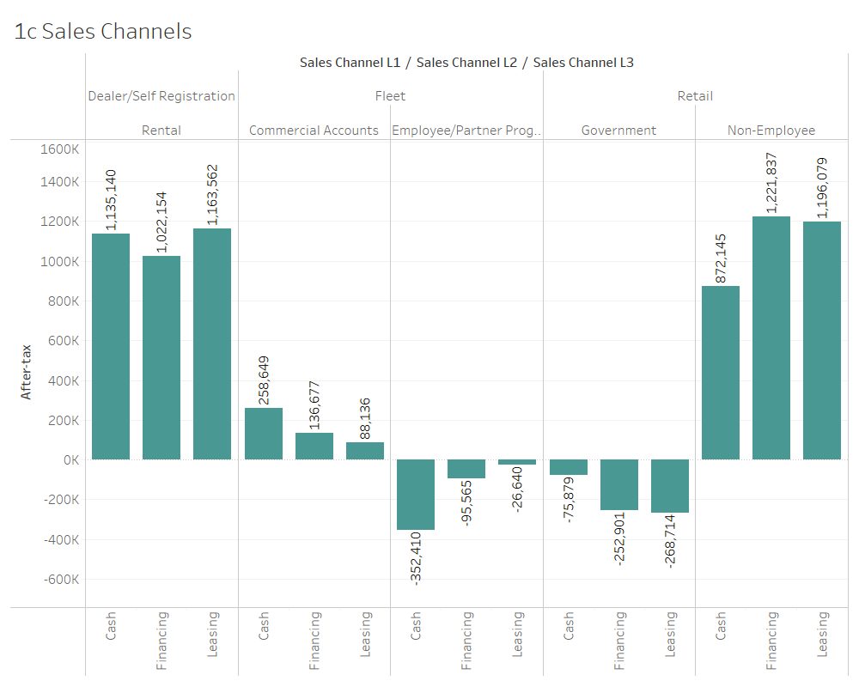
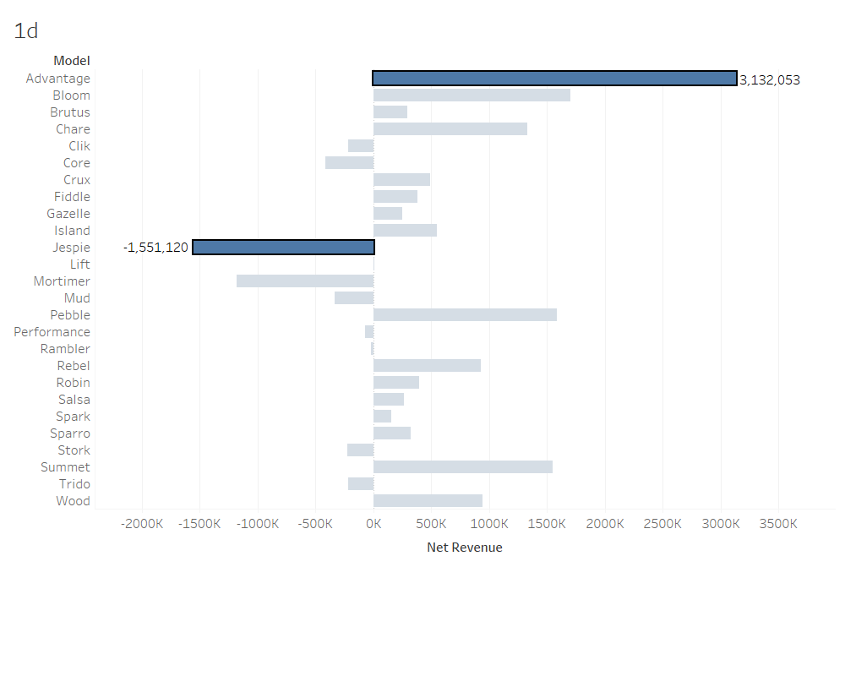
Overall Performance Analytics:
c. How are the various sales channels performing?
In terms of after tax revenue, Dealer/Self Registration has the most revenue accounting to almost 55.14% of the total after tax revenue, followed by Retail with 44.71%. Fleet has the least after tax revenue making to only 0.15% of the total revenue. Comparing Sales Channel 2, Rental accounts to the most revenue of around 55.14%, followed by Non-Employee with 54.63%, and Commercial Accounts with 8.03%. In Sales Channel 3, leasing accounts to most revenue accounting up to 35%, followed by Financing with 33.74% and Cash with around 30% respectively.
d. What are the most & least profitable models?
Advantage is the most profitable model with Total revenue of around 3,132,053 and Jespie is the least profitable model with negative revenue of 1,551,120. In terms of after tax revenue, Advantage has the most profitable model of around 2,898k and Jespie has the least profitable model with negative after tax revenue of around 1,675k.

Slide 11
Financial Analytics:
What is the current CM per model?
What the average variable cost per model and how has that changed over time?
Which model has the most variability in variable costs?
What is the current CM per channel?

Slide 12
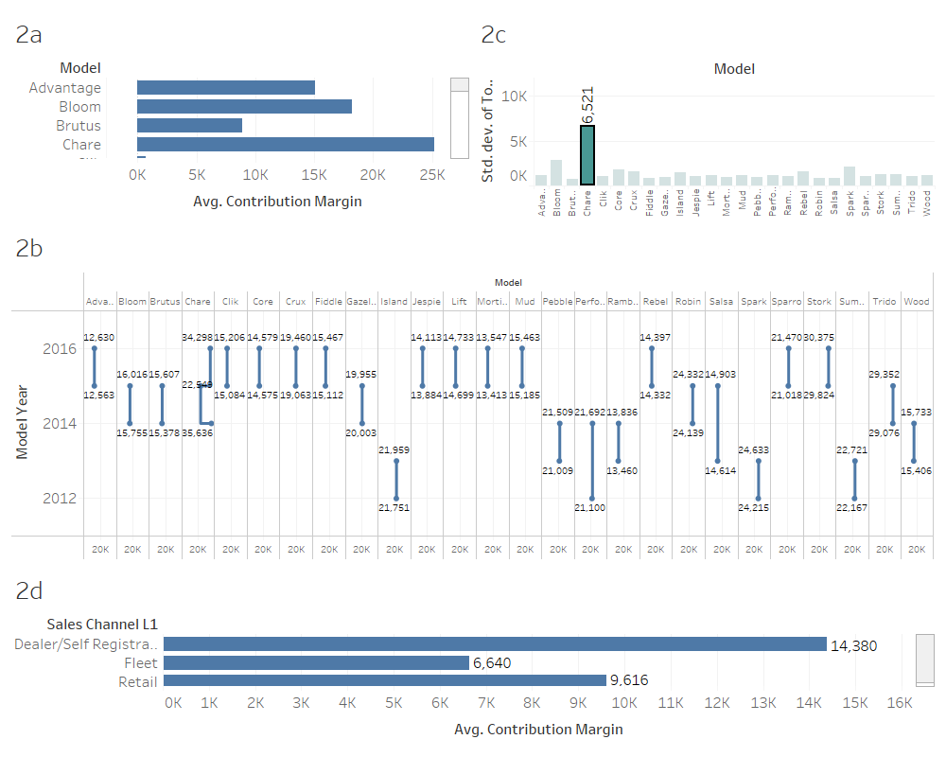

Slide 13
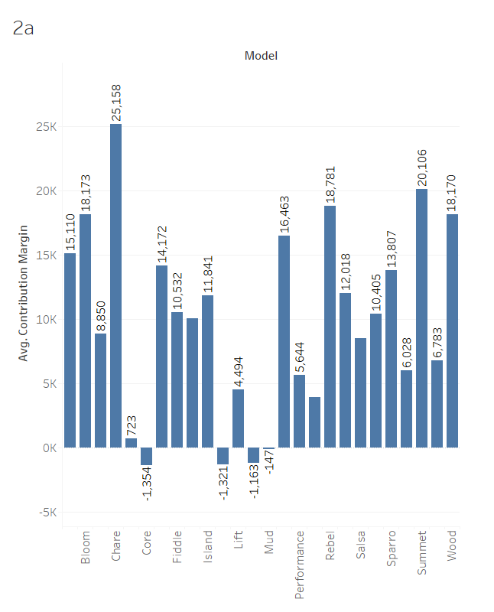
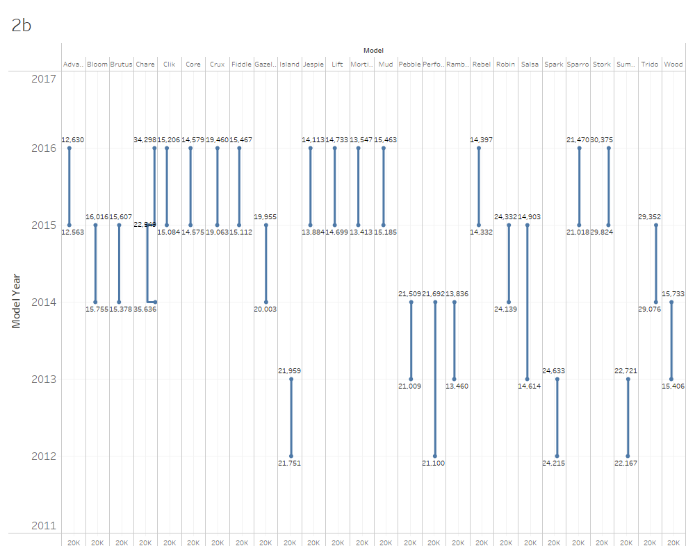
Financial Analytics:
What is the current CM per model?
Chare has the highest Average CM of around 25,158, followed by Summet and Rebel with 20,106 and 18,781 respectively. Core, Jespie, Mortimer have the least Average Contribution Margin with negative values of around -1353, -1320, and -1163 respectively.
b. What is the average variable cost per model and how has that changed over time?
The average variable cost has been increasing every year for every model except Chare and Gazelle model. Chare had a minor decrease in its average variable cost from 35,636 to 22,949 in 2015 but then it increased to 34,298 in 2016. Gazelle on the other hand had a very slight decrease in its average variable cost from 20,003 in 2014 to 19,955 in 2015.

Slide 14
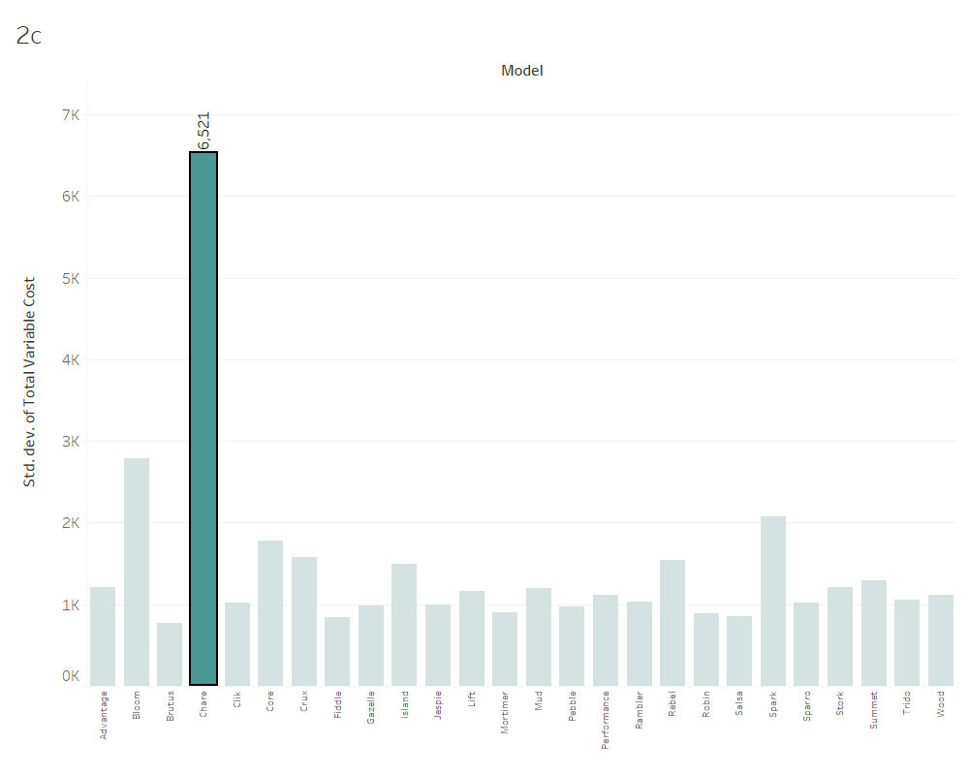
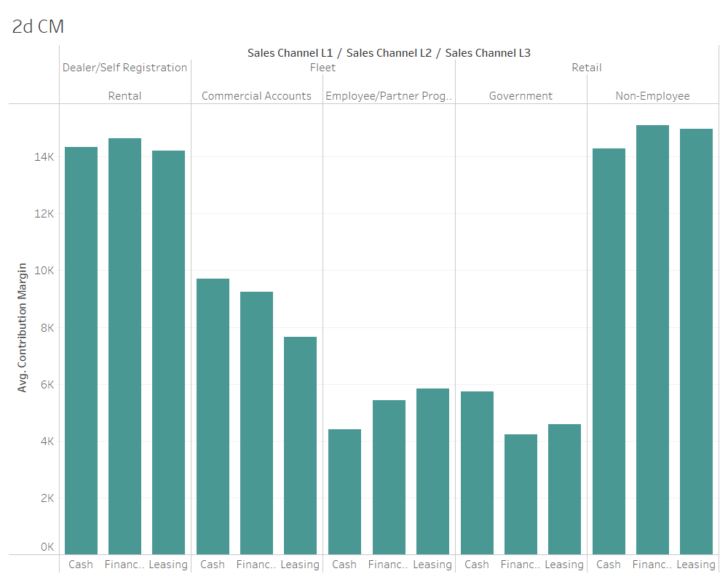
Financial Analytics:
c. Which model has the most variability in variable costs?
The model with the highest standard deviation is the model with the most variability in variable costs. Chare has the highest Standard Deviation of Total Variable Cost of around 6,521, showing that it has the most variability in the models.
d. What is the current CM per channel?
In Sales Channel 1, Dealer/Self Registration has the highest average CM of around 14,380 followed by Retail and then Fleet. Comparing Sales Channel 2, Non-Employee has the highest CM of around 14,825 followed by Rental, Commercial Accounts, and Employee/Partner Programs respectively. In Sales Channel 3, Financing is on the lead with Average CM around 9645, followed by Leasing and Cash.

Slide 15
Operations Analytics:
What model options are the top and bottom sellers?
How many days are the various models on the lot prior to sale?

Slide 16
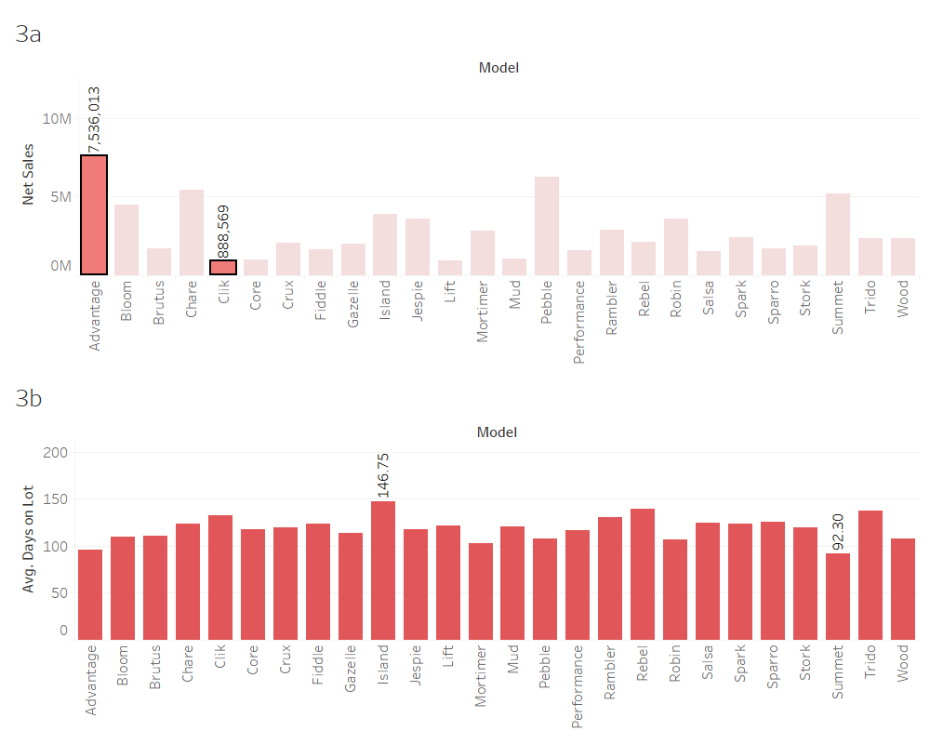

Slide 17
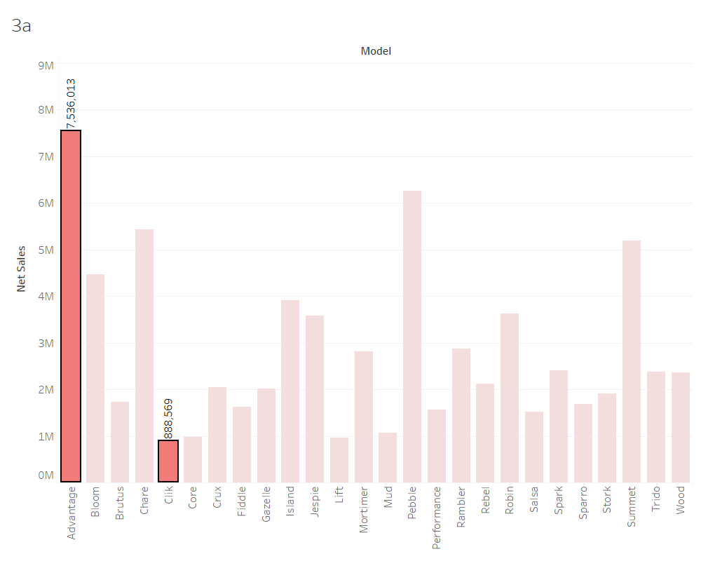
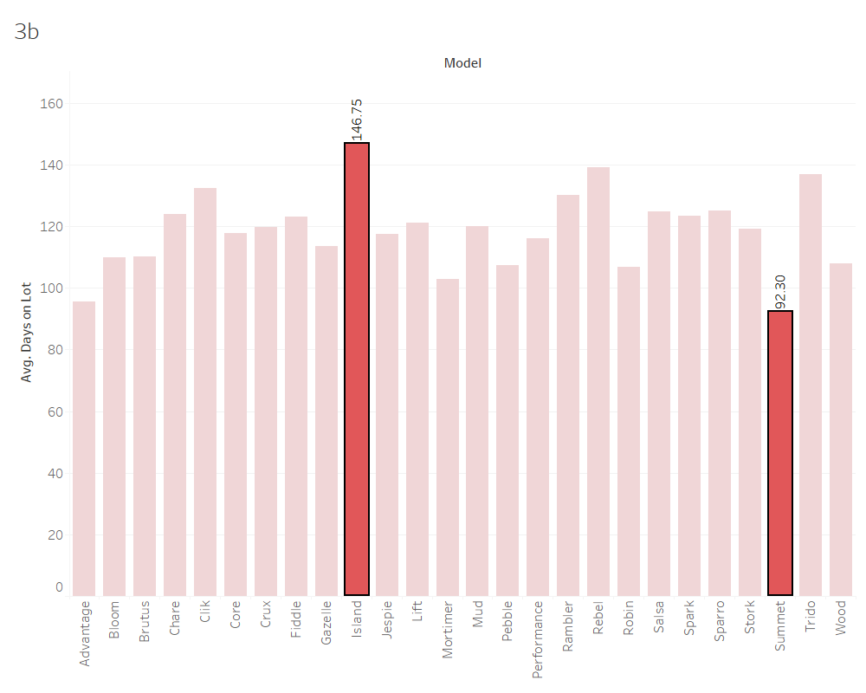
Operations Analytics:
What model options are the top and bottom sellers?
The top seller is Advantage Model of around 7,536,013 Total Net Sales, and the bottom seller is the Clik Model with only 888,569 Total Net Sales. Advantage Model accounts to 10.33% of the total Net sales, followed by Pebble Model with 8.59%, and Summet Model with 7.12%.
b. How many days are the various models on the lot prior to sale?
Island model stays the most on the lot with an average of around 146 days, whereas Summet model stays the least on the lot with an average of around 92 days only.

Slide 18
Forecast:
Sales Volume ‐ 4 quarters in advance
Contribution Margin ‐ 4 quarters in advance

Slide 19
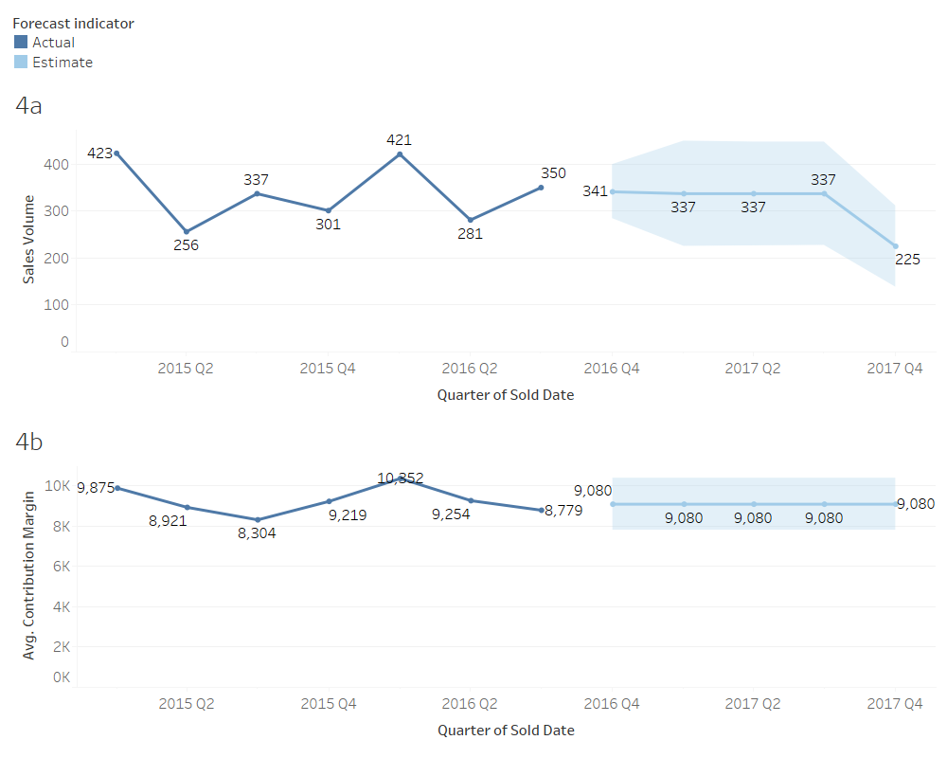

Slide 20
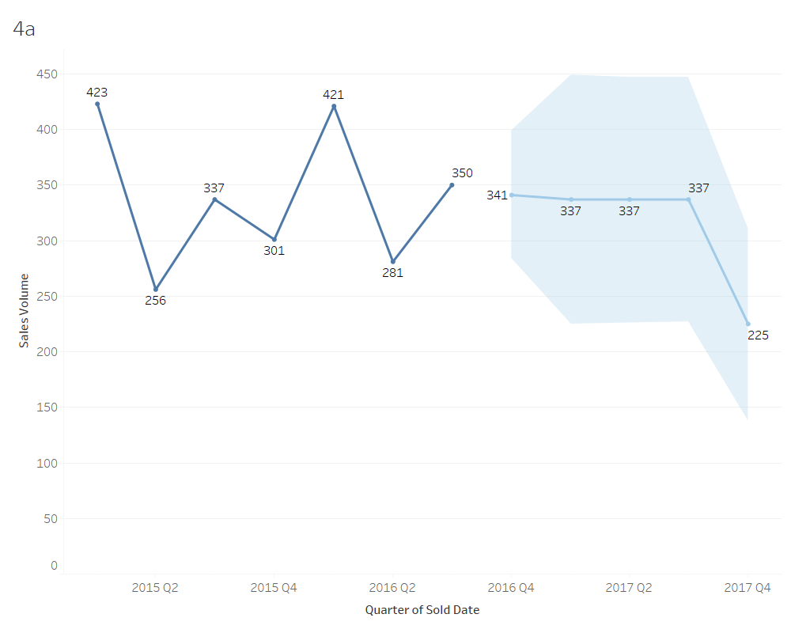
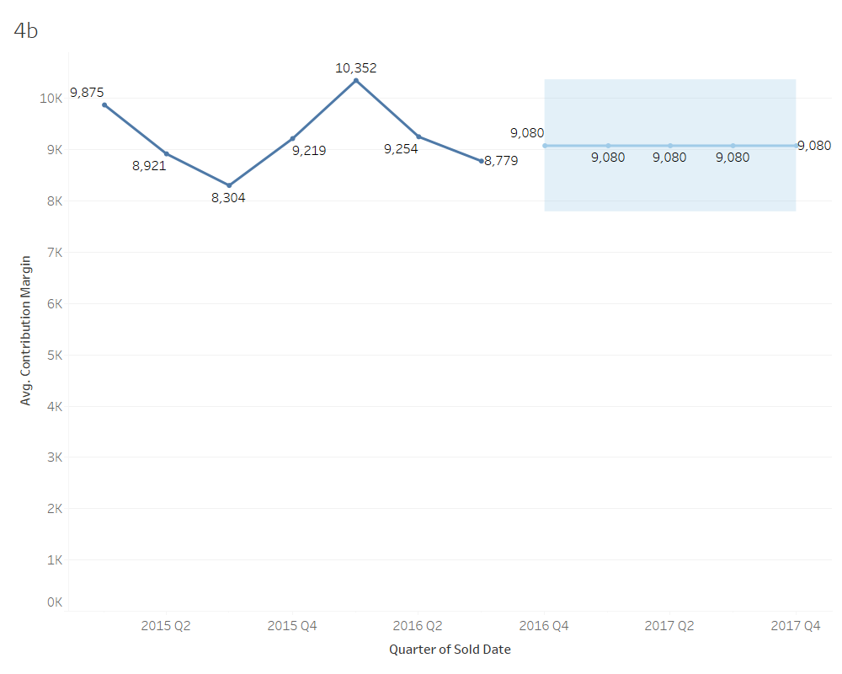
Forecast:
Sales Volume ‐ 4 quarters in advance
The estimated sales volume for the next 4 quarters in advance have seen a decrease in the sales volume from 350 to 341 (2.6%), and then a decrease to 337 (3.8% from 350) and then heavy decrease to 225 (49% from 337) by 2017 Q4.
b. Contribution Margin ‐ 4 quarters in advance
Contribution Margin is expected to increase from 8779 to 9080 which is around 3.4% in the coming quarter and is expected to remain stable for the next 4 quarters. More precise values can be found if there is consistent data about the 2015 and 2016 years.

Slide 21
Recommendations
Based on the analysis, to improve its regional presence, HMC should focus on increasing sales in Asia and Europe since regions like Asia-Pacific have a booming market and HMC has a lot of scope in taking this as an advantage in the region. The company can also look into expanding into Middle East and South American regions to get a strong international presence.
The company should also focus on improving the profitability of its other brands such as Jackson which generates around 23.34% of the total revenue, but only 20.96% of the sales.
Also, Models such as Jespie and Mortimer which have the least profitability can be discontinued since the after tax revenue is also in negative values.
The brands with low CM such as Special can be rechecked and valuated to improve the quality or decrease the price to improve its profit margin.

Slide 22
Recommendations
Also, eliminating sales channels such as, Fleet which has the least after tax revenue making to only 0.15% of the total revenue could help in spending resources on profitable sales channels like Dealer/Self Registration which has the most revenue accounting to almost 55.14% of the total after tax profit.
Some potential implications such as, eliminating the Jespie model would reduce costs, but it could also lead to a loss of sales. Also, improving the profitability of the Jackson brand would also lead to increased revenue and profit.
HMC can utilize the estimated forecast to understand the market demands and the required models that could bring in better profitability. To improve sales volume, the company could target on improving its global presence through marketing initiatives, social media presence, diversifying its channels, adopting better strategies with models and brands, etc. These may help the company in making better data informed decisions.

Slide 23


THANK YOU
Sohini Chintala

